Slide 1
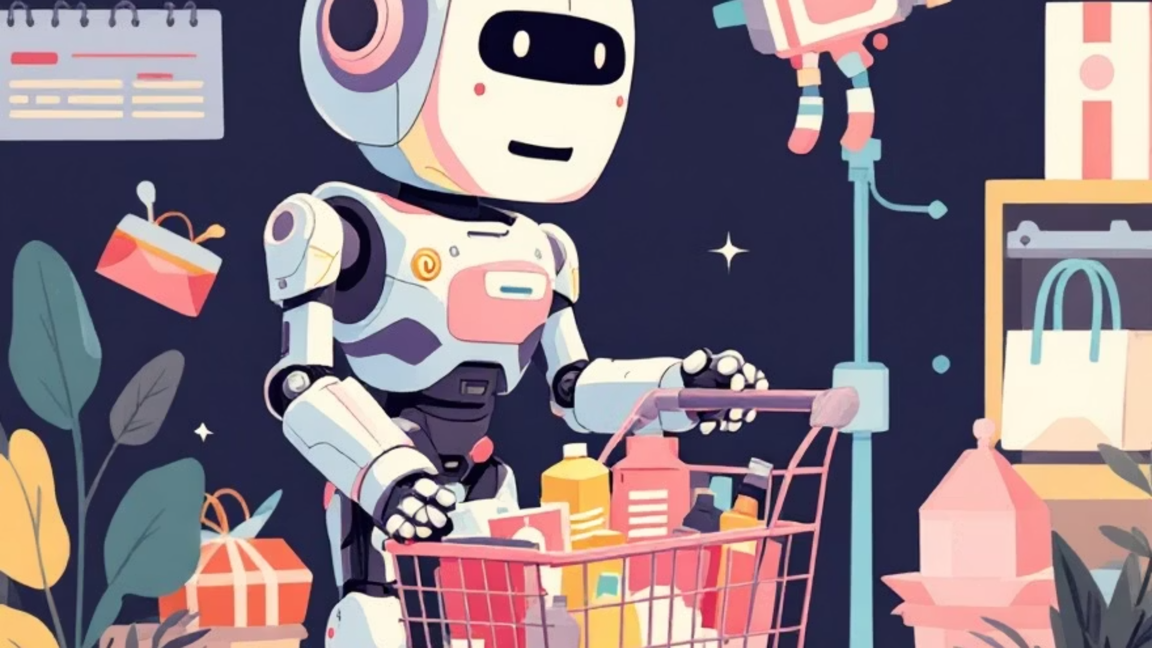
UnixShopBot: AI Chatbot for E-Commerce Built on Shell and Node.js
Team Members:
Ayush Kala (A010145024098)
Tanushka Rathore (A010145024107)
Dhruv Kaushik (A010145024248)
Adarsh Kumar (A010145024117)
Course: MCA (Integrated Project)
Guide:. Prof.(Dr.)Himanshu Gupta & Dr. Sudhriti Sengupta,
Institute: Amity Institute of Information Technology

Slide 2

🧠 2. Introduction of Project
The project ShopSphere is an AI-driven ChatBot integrated into an e-commerce website.
It helps users interact naturally to search for products, explore discounts, and get recommendations.
The chatbot uses Gemini AI (Google’s Generative Model) for intelligent responses.
Backend
Data & Automation
The backend is powered by Node.js + Express, and the frontend is built using React.js.
All conversations are stored in MongoDB Atlas, and Unix Shell scripts automate backend operations.

Slide 3










📄 3. Abstract
This project demonstrates how Artificial Intelligence can be used in online shopping assistance. The system integrates:
Frontend (React.js)
Backend (Node.js + Express)
Gemini AI Model
for user interaction.
for communication and data handling.
for generating responses.
MongoDB Atlas
Unix Shell Automation
for storing user chat history.
for maintaining and monitoring the backend.
The chatbot provides quick answers, searches for products, and improves user experience through automation.

Slide 4
💡 4. Introducing the Project (in Points)
1
User-friendly Interface
React-based frontend interface.
2
Smart AI Core
AI chatbot powered by Gemini API for smart replies.
3
Robust Backend
RESTful backend API built with Node.js and Express.
4
History Management
Chat history management using MongoDB Atlas.
5
Operational Automation
Integration of Unix Shell scripts for server commands and data updates.
6
Flexible Interaction
Supports both user messages and quick questions.
7
Enhanced UI
Interactive UI with smooth scrolling and message formatting.

Slide 5
⚙️5. Software and Hardware Required Configuration
Software Requirements:
Hardware Requirements:
OS: Windows / macOS / Linux
Processor: Intel i5 or above
Frontend: React.js
RAM: 8 GB minimum
Backend: Node.js (v18 or above)
Disk Space: 500 MB (for project)
Database: MongoDB Atlas
Internet: Required for Gemini API
AI Service: Gemini API (Google)
Automation: Unix Shell
IDE: VS Code
Browser: Chrome / Edge

Slide 6






🛠️ 6. Implementation
The ShopSphere architecture is built on distinct layers:
Frontend
Backend
AI Layer
React components for chatbot and store interface (App.js, ChatBot.js, EcommerceStore.js).
Node.js with Express routes for /chat endpoint.
Gemini API integration via LangChain to process messages.
Database
Shell Layer
MongoDB Atlas used to store chat threads (message, threadId, sender).
Used to monitor, start, or restart the backend using Unix commands.
Flow:
User → React UI → Express API → Gemini AI → MongoDB → Response → User

Slide 7
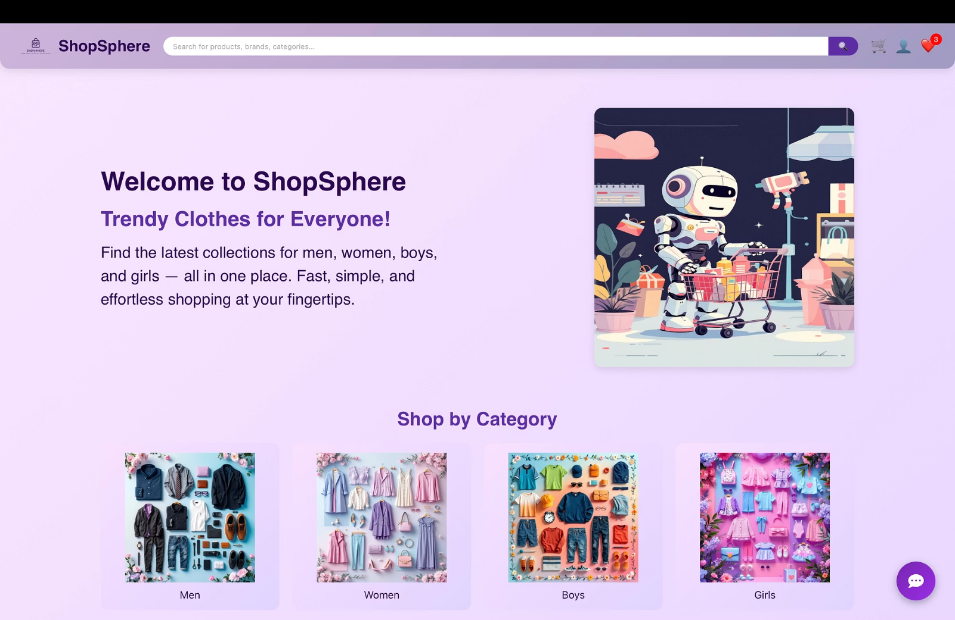
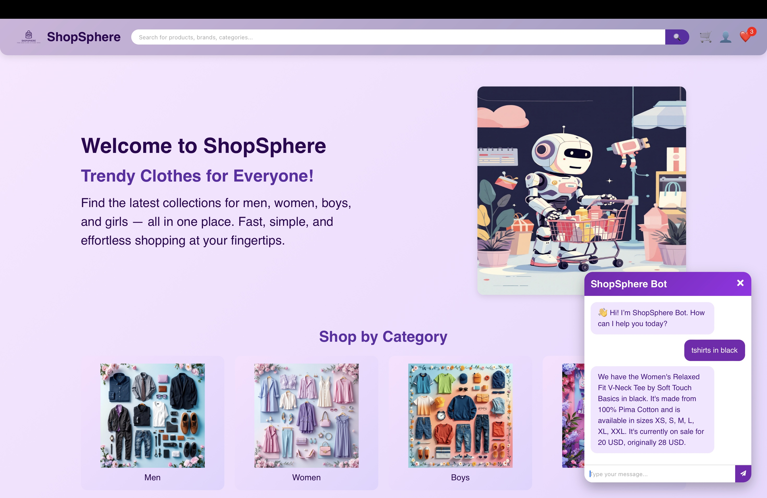
🖼️ 7. Output Screenshots,
Visualise the key components of the ShopSphere project:

Slide 8
✅ 8. Conclusion
The ShopSphere ChatBot successfully demonstrates integration of AI with e-commerce.
Intelligent Customer Experience
Process Automation
Harmonious Integration
It automates backend processes using Unix shell scripting.
It showcases how different technologies (React, Node, MongoDB, Gemini AI) can work together in harmony.
It provides an interactive and intelligent experience for customers.

Slide 9

🚀 9. Future Scope
Voice Interaction
Add voice-based interaction for users.
Real Product Integration
Integrate real product APIs from Amazon/Flipkart.
Global Reach
Implement multi-language support.
Customer Insight
Add sentiment analysis to understand customer mood.
Enhanced Personalization
Improve personalized recommendations using user history.
Scalable Deployment
Host on cloud platforms like AWS or Google Cloud for public access.

Slide 10





📚 10. References
React.js Official Documentation
Node.js Express Guide
Gemini API Docs (Google AI)
MongoDB Atlas
LangChain JS Documentation
Unix Shell Commands

Slide 11
THANK YOU

